Slide 1
The Seven Most Important Takeaways from This Class
By Prof. Fernández-Loría
(huge thanks to Foster Provost for many lessons and slides)

Slide 2
But first a few things regarding the final exam…

Slide 3
Hands-on part (6% of the 35%)
Questions?
It will be released on Thursday 14 at 00:01 am.
Once you start, you have 24 hours to submit your answer or until December 22nd at 11:59pm, whichever occurs first.
Must be done individually.
Ensure stable connection and proper equipment. No retests available.
Upload two files: your decisions (1s and 0s) and your Dataiku project or Python files (I won’t grade your project; it’s just a control check).
The better your decisions, the better your grade.
TAs and I won’t answer content-related questions about the exam.

Slide 4
Written part (29% of the 35%)
Questions?
It will be released on Thursday 14 at 00:01 am.
Once you start, you have 3 hours to submit your answer or until December 22nd at 11:59pm, whichever occurs first.
Must be done individually.
Ensure stable connection and proper equipment. No retests available.
Open-book: notes + book + Internet + ChatGPT
Questions are multiple choice and fill in the blanks.
TAs and I won’t answer content-related questions about the exam.

Slide 5
One Last Thing:
My last office hours are on Dec 14th.
I will have very limited access to my computer from Dec 15th onwards, so try the TAs first. Of course, you can always copy me.

Slide 6
#1
Craft your solutions with a strong emphasis on the dimensions of value you want to deliver.

Slide 7

Framework #2: Dimensions of Value
Understand
(Often Causal)
Improve
(Decision Making)
Enable
(New Decisions)
What the business wants
Predictive Analytics
What the business
should already be doing
Fact-finding, Summarization, Visualization,
Hypothesis Testing, Data Engineering, …

Slide 8
Framework #2: Dimensions of Value
Understand
(Often Causal)
Improve
(Decision Making)
Enable
(New Decisions)
Most of this course was devoted to understanding how to use data to maximize profits, minimize costs, etc.
We discussed churn, targeted marketing, demand prediction, investment decisions, customer service, etc.
More on this as we move forward today...

Slide 9
Framework #2: Dimensions of Value
Understand
(Often Causal)
Improve
(Decision Making)
Enable
(New Decisions)
We can also build models that describe which variables correlate with a variable of interest. In these cases, the goal is often to infer causal associations. Causal inference involves predicting what would have happened with & without the cause.
Be mindful about making apples-to-apples comparisons.

Slide 10
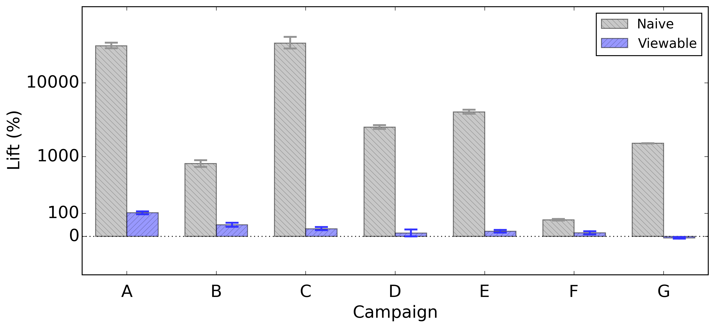
Ad visibility as a “natural experiment”
The naive analysis of comparing users who received ads with users who didn’t receive ads results in a drastic overestimation compared to an analysis that takes visibility into account.
Example thanks to Integral Ad Science (IAS).
Notes:
Important to have learned the fundamental principle, rather than just some techniques – because we might get clever and find other ways to simulate the counterfactual.

Slide 11
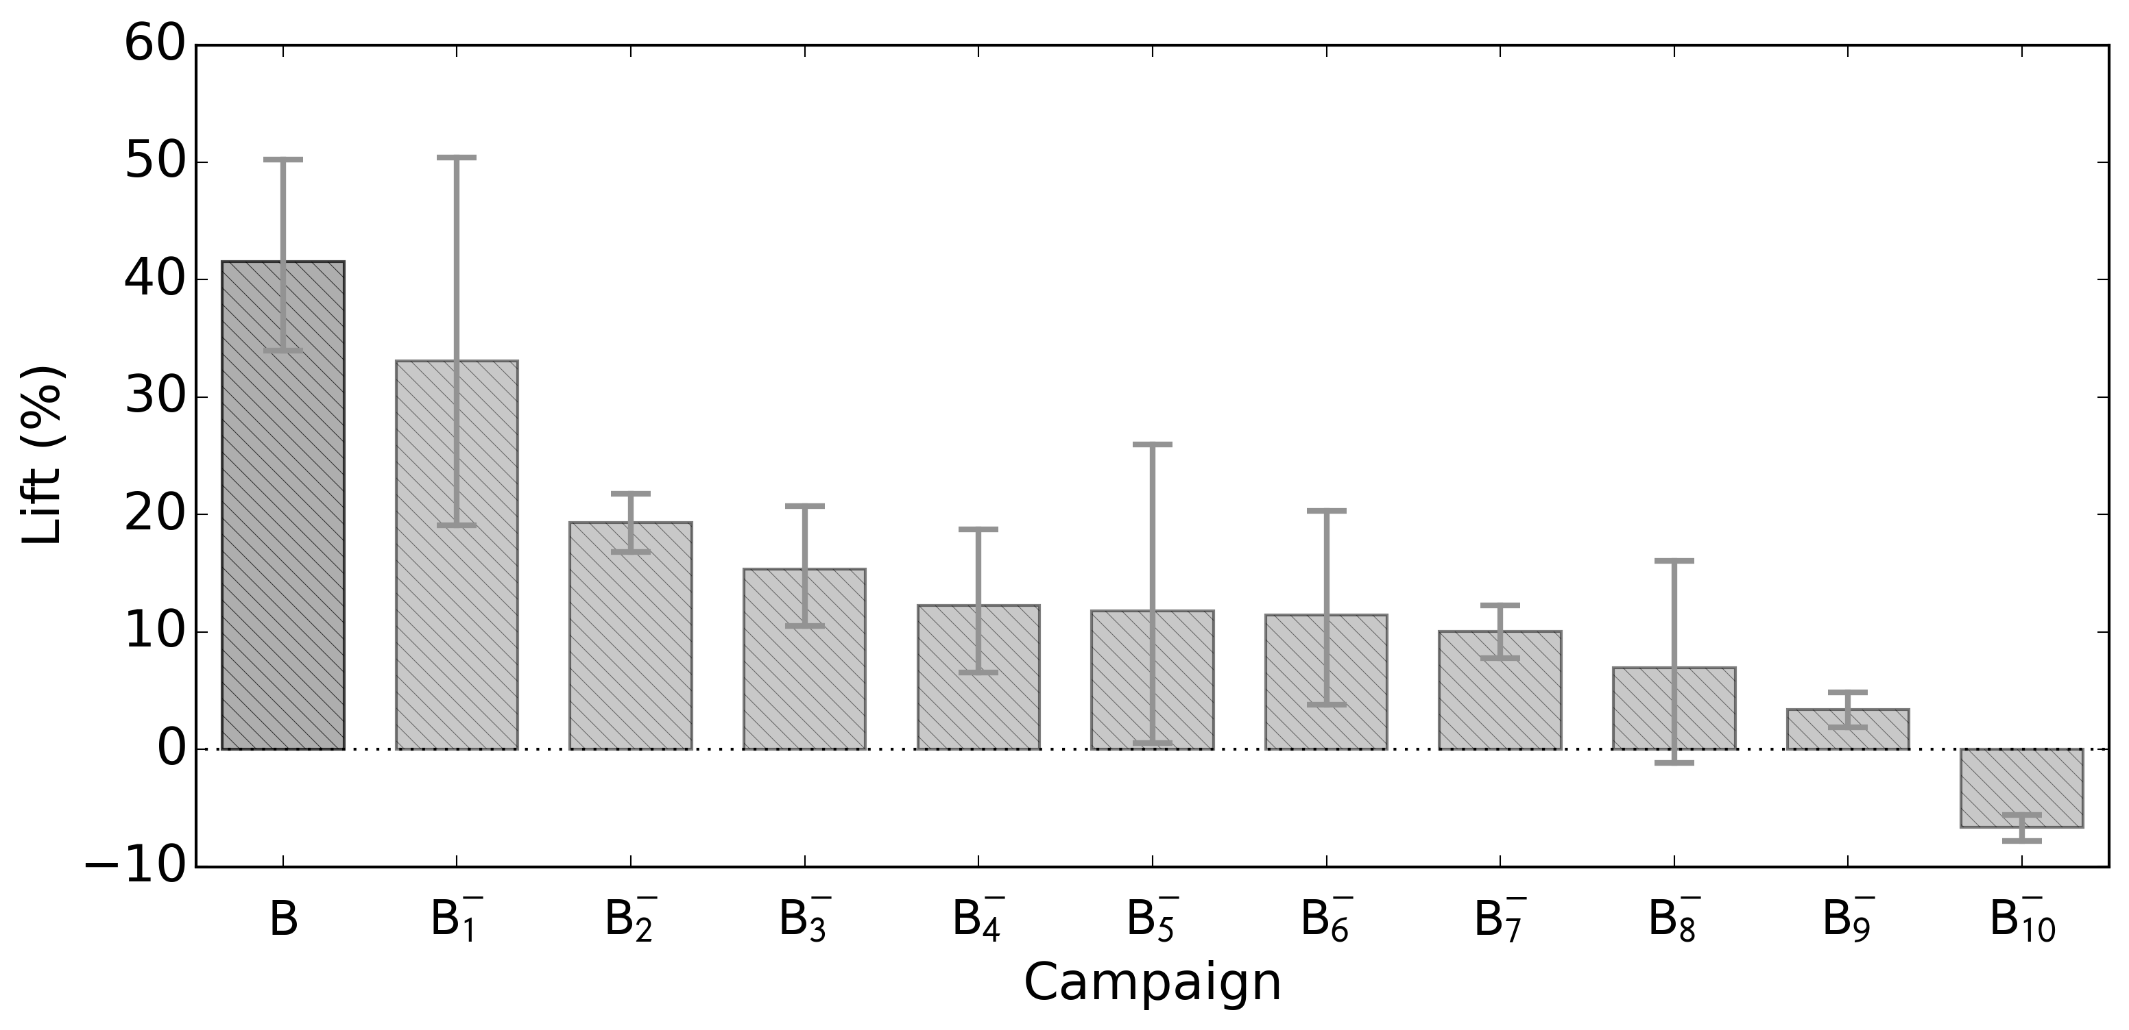
Validation of Campaign B with negative controls

Slide 12
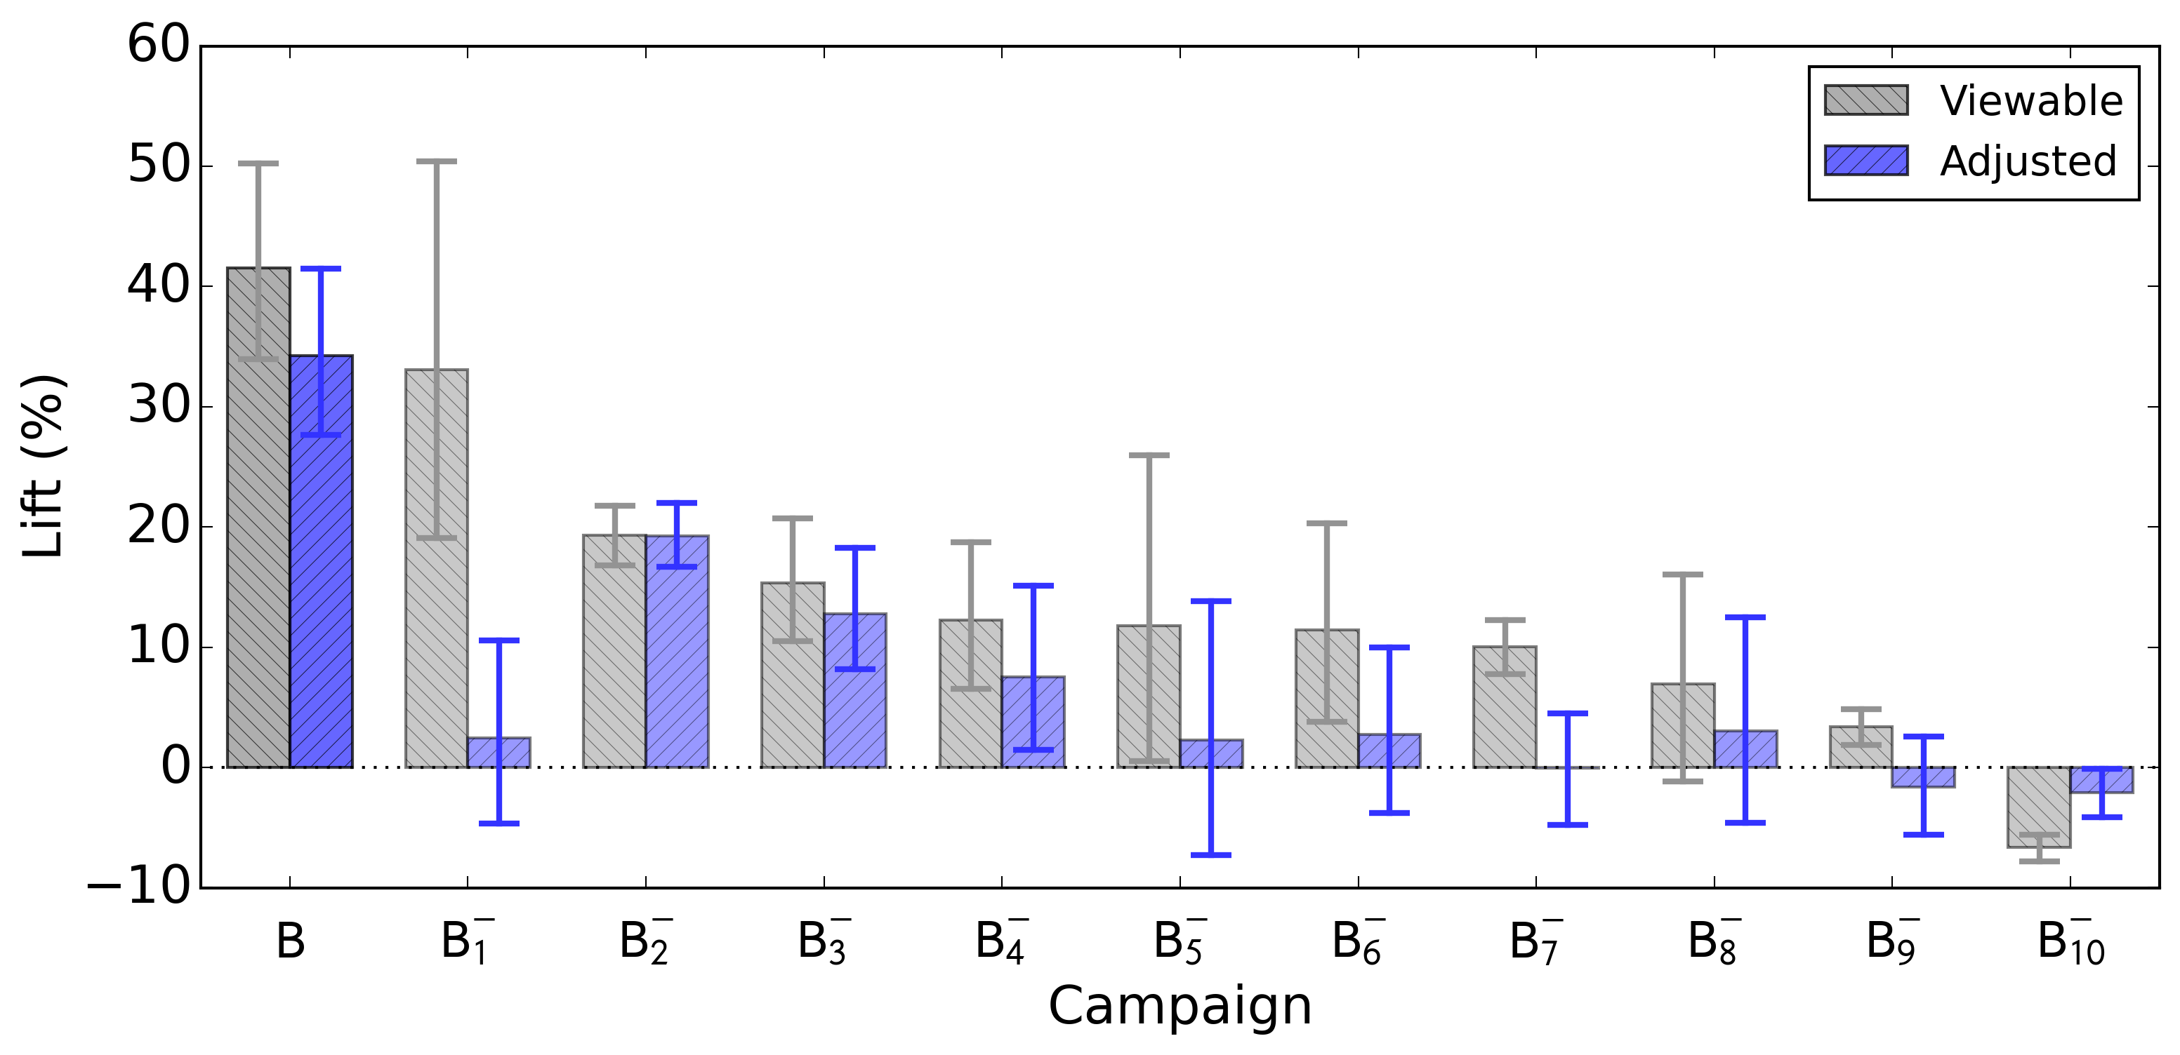
Adjusted Lift*: Campaign B & Negative Controls
*Use natural experiment + add controls for other confounders

Slide 13




Framework #2: Dimensions of Value
Understand
(Often Causal)
Improve
(Decision Making)
Enable
(New Decisions)
As we invest in data and analytics for a project, we enable new applications and the opportunity to create other data-driven solutions with substantially less investment.
Notes:
Amazon: data from recommender systems for pricing and selling their own products
Spotify: Could potentially make their own music label (just as Netflix produces its own movies).
ChatGPT: Can get a sense of the demand for gen AI in different areas and industries.

Slide 14

Framework #2: Dimensions of Value
Improve
(Decision Making)
Enable
(New Decisions)
As we invest in data and analytics for a project, we enable new applications and the opportunity to create other data-driven solutions with substantially less investment.

Slide 15
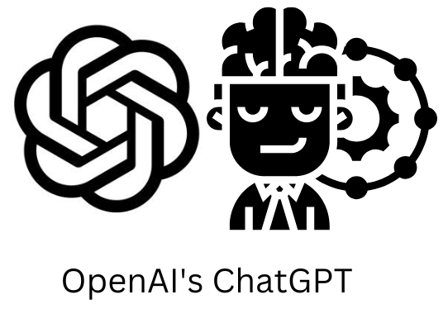
Framework #2: Dimensions of Value
?
Enable
(New Decisions)
As we invest in data and analytics for a project, we enable new applications and the opportunity to create other data-driven solutions with substantially less investment.

Slide 16
#2
There are two important processes in predictive analytics: creating and using models. Understanding how they differ and relate is key for formulating predictive analytics solutions.

Slide 17



Using an AI system for decision-making
Action
Data Instance
Example: give retention offer (or not)
Example: a customer

Slide 18



What is really happening inside the AI’s head:
AI in Use (Inference):
Action
Prediction/Inference
Data Instance
Decision Logic
Model
Data for inference – some target value is unknown
Notes:
use cross-sell offer as running example for a while here? -→ following banking example (don’t want to bother lots of customers)

Slide 19
Where does the knowledge to infer come from?
AI in Use (Inference):
Action
Prediction/Inference
Data Instance
Decision Logic
Model
Notes:
use cross-sell offer as running example for a while here? -→ following banking example (don’t want to bother lots of customers)

Slide 20

Part I
AI in Use (Inference):
Action
Prediction/Inference
Data Instance
Decision Logic
Model
Notes:
use cross-sell offer as running example for a while here? -→ following banking example (don’t want to bother lots of customers)

Slide 21
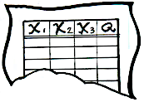

Part II
Machine Learning:
X₁
X₂
X₃
Q
8
T
Red
Yes
12
F
Blue
No
6
T
Blue
Yes
Red
No
Labeled Data
Machine Learning Algorithm
Learned Model
AI in Use (Inference):
X₁
X₂
X₃
Q
Red
?
Action
7
T
Data Instance
Predicted Quantity
Model
Decision Logic

Slide 22
Framework #3: AI in Use vs. Machine Learning
Machine Learning:
X₁
X₂
X₃
Q
8
T
Red
Yes
12
F
Blue
No
6
T
Blue
Yes
Red
No
Labeled Data
Machine Learning Algorithm
Learned Model
AI in Use (Inference):
X₁
X₂
X₃
Q
Red
?
Action
7
T
Data Instance
Predicted Quantity
Model
Decision Logic

Slide 23
#3
A data analytics undertaking involves a ton of stuff. The data science process can help us organize it all in our minds.

Slide 24
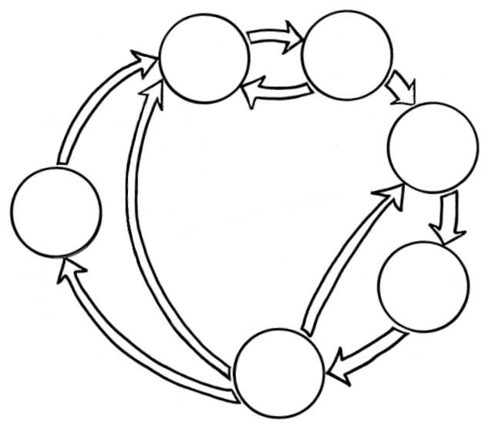
What makes the biggest difference:
Business Understanding
Data Understanding
Data Preparation
Framework #1: Data Science
Process
Deployment
Modeling
Evaluation

Slide 25
Framework #4: Questions for Problem Formulation
Q1: What decision is the solution intended to support?
Q2: What will be the entity to be represented by a data instance?
Q3: How will the decision be evaluated?
Q4: What quantity would be useful to know or predict to inform the decision (target variable)?
Q5: What other factors are relevant for decision making (costs, benefits, constraints, etc.)?
Q6: (How) Can we get target labels for supervised machine learning?
Q7: What data (features) could be useful to predict the target?

Slide 26
Framework #3: AI in Use vs. Machine Learning
#1 Problem Formulation and #2 Data Engineering.
Machine Learning:
X₁
X₂
X₃
Q
8
T
Red
Yes
12
F
Blue
No
6
T
Blue
Yes
Red
No
Labeled Data
Machine Learning Algorithm
Learned Model
AI in Use (Inference):
X₁
X₂
X₃
Q
Red
?
Action
7
T
Data Instance
Predicted Quantity
Model
Decision Logic

Slide 27
What about the fancy ML techniques?
Business Understanding
Data Understanding
Data Preparation
Framework #1: Data Science
Process
Deployment
Modeling
Evaluation

Slide 28
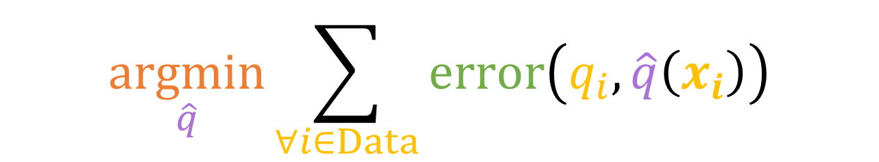
Framework #5: Components of Machine Learning
Machine learning algorithms are programs that fit a model to data based on an evaluation criterion.
Representation $+$ Evaluation $+$ Optimization
We focused mostly here.
$$\underset{\hat{q}}{argmin}{\sum_{∀i∈Data}{error\left(q_{i},\hat{q}\left(x_{i}\right)\right)}}$$

Slide 29
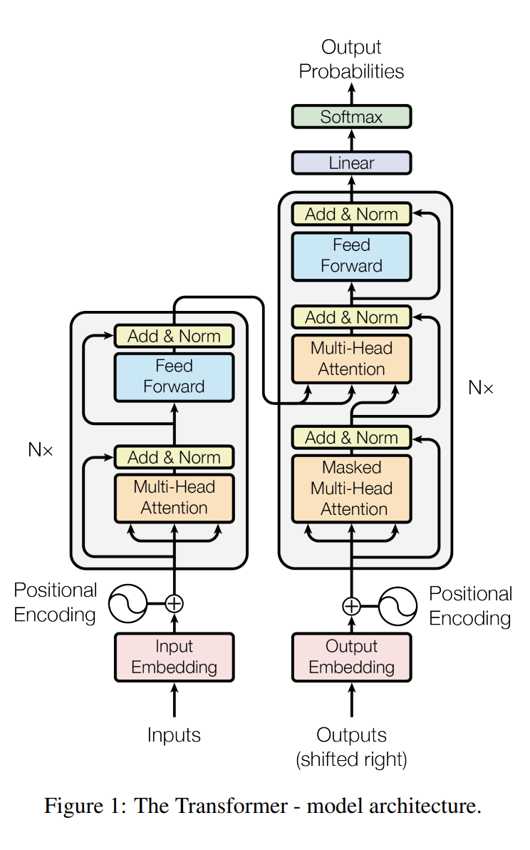
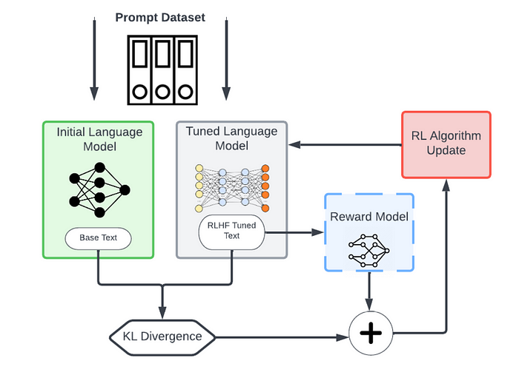
Learning = Representation $+$ Evaluation $+$ Optimization
GPT
Representation
Evaluation
Predict next word
Human feedback (simulation)

Slide 30
#1 Problem Formulation and #2 Data Engineering.
Inspired by
Representation
Evaluation
Predict next word
Human feedback (simulation)

Slide 31
#4
When we reason about a business problem, the expected value framework helps us move from a unique problem to a data science solution.

Slide 32
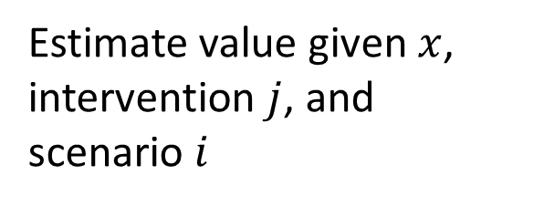
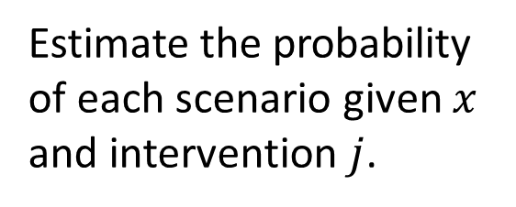
The expected value framework divides the problem into probability estimates, value estimations, and cost-benefit estimations.
Decision Logic $=$ Choose intervention with largest expected value.
Estimate the probability of each scenario given $x$ and intervention $j$.
VALUE MATRIX
 | Scenario 1 | … | Scenario N
Control
Intervention 1
…
Intervention K
Decisions
Estimate value given $x$, intervention $j$, and scenario $i$
Scenarios
These are classic data science problems!

Slide 33
#5
Modern statistical modeling and machine learning is all about complexity control.

Slide 34
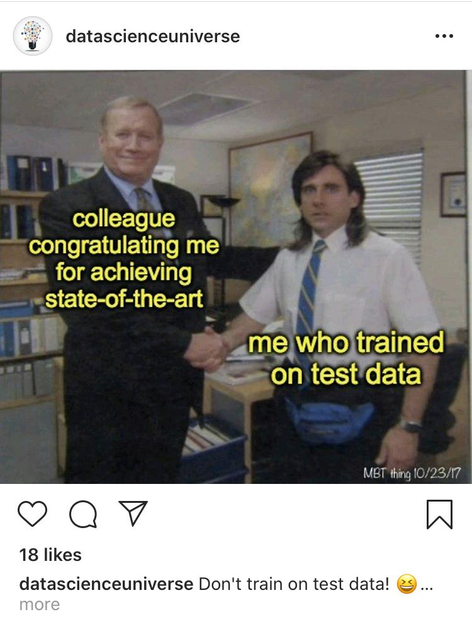

Slide 35
Framework #3: AI in Use vs. Machine Learning
#3 Complexity control and avoid overfitting.
Machine Learning:
X₁
X₂
X₃
Q
8
T
Red
Yes
12
F
Blue
No
6
T
Blue
Yes
Red
No
Labeled Data
Machine Learning Algorithm
Learned Model
AI in Use (Inference):
X₁
X₂
X₃
Q
Red
?
Action
7
T
Data Instance
Predicted Quantity
Model
Decision Logic

Slide 36
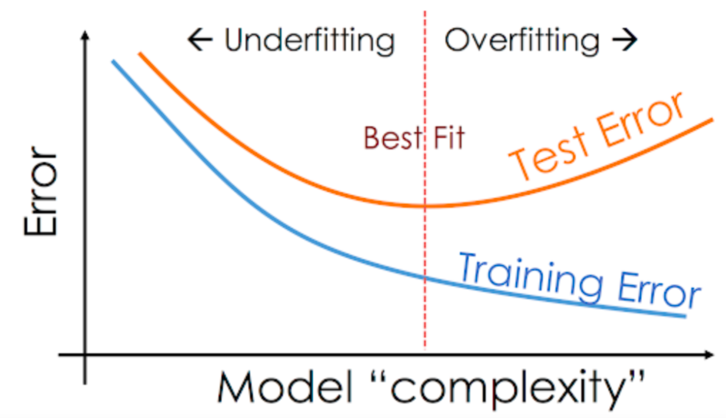
Fitting curves

Slide 37
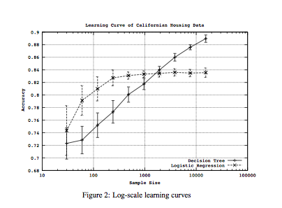
Learning curves
Notes:
Sources of error: Inadequate features; bias & variance

Slide 38
#6
Your models will be wrong!

Slide 39

Perhaps my favorite data science quote.
“All models are wrong…
…. but some are useful.”
― George E. P. Box

Slide 40
George Box frees us to explore all types of models, proxies, etc.
Key to success:
Business Understanding Evaluation

Slide 41
Business Understanding
Data Understanding
Data Preparation
Framework #1: Data Science
Process
Deployment
Modeling
Evaluation

Slide 42
Framework #6: Expected Value
Also a data-driven framework to test solutions!
Predictive Power
Business Value
CONFUSION MATRIX
 | + | -
Y
N
BENEFIT MATRIX
 | + | -
Y
N
EV
Decisions
Scenarios

Slide 43
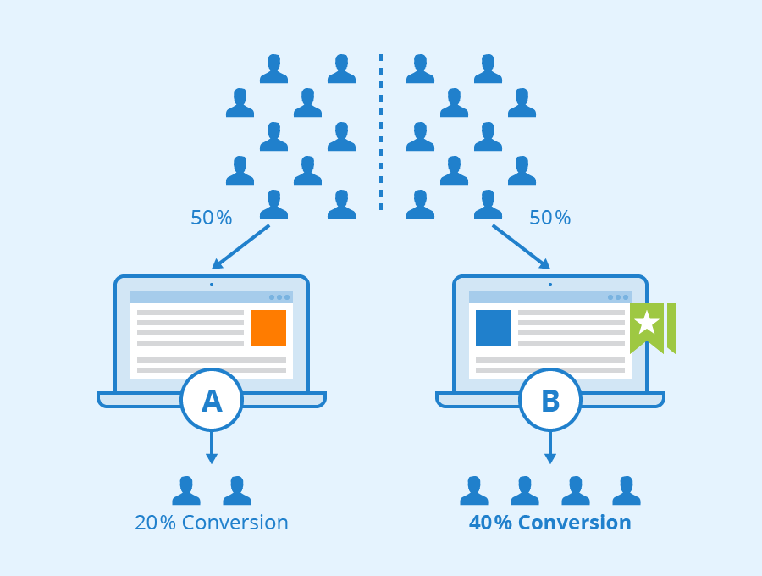
A/B testing (for data collection and evaluation)

Slide 44
#7
But first… a fairy tale...

Slide 45
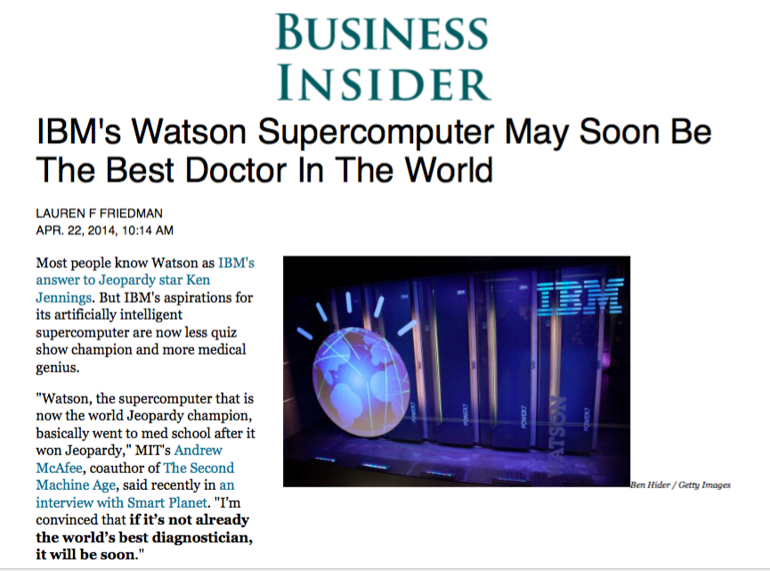

Slide 46
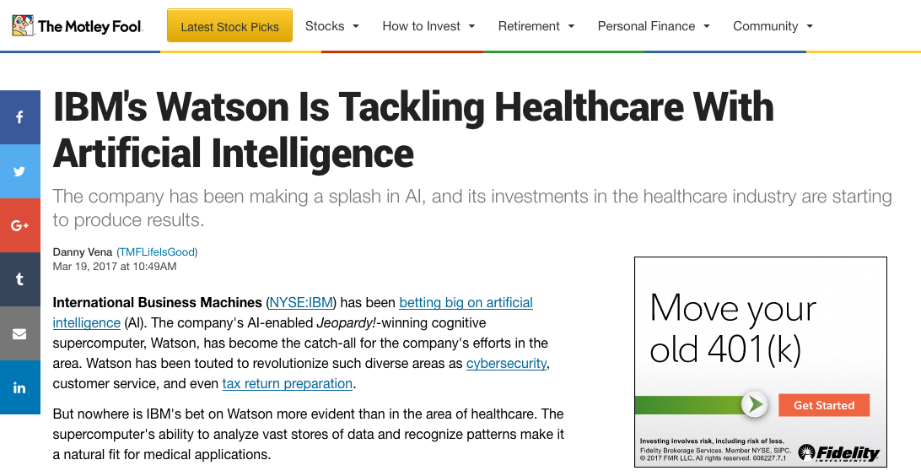

Slide 47
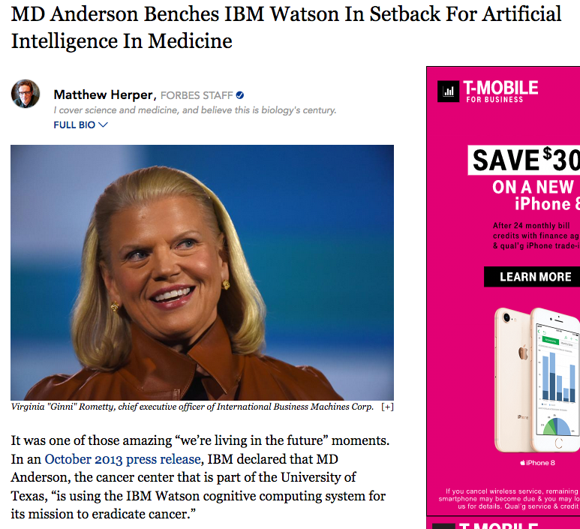
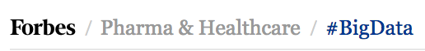

Slide 48
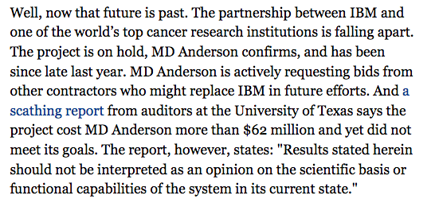

Slide 49
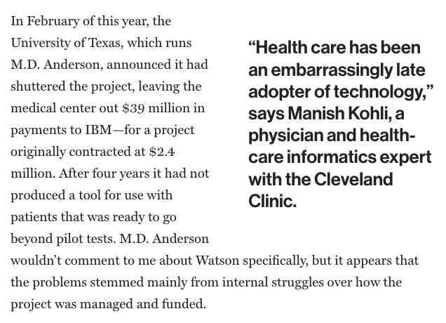

Slide 50
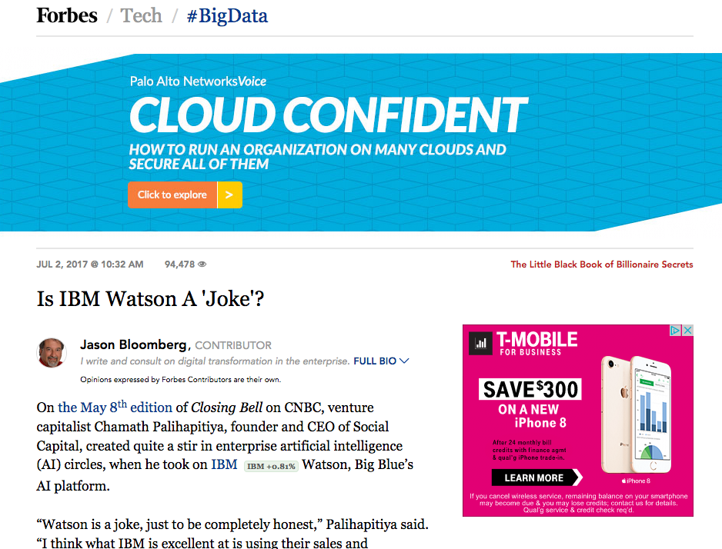

Slide 51
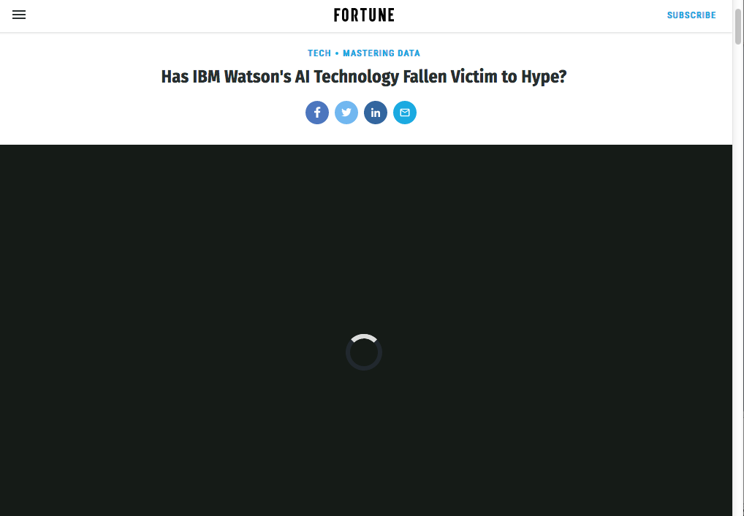
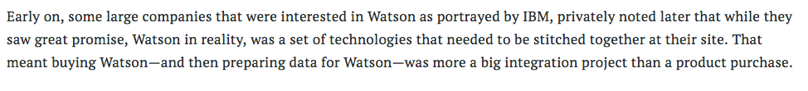
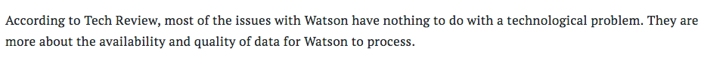
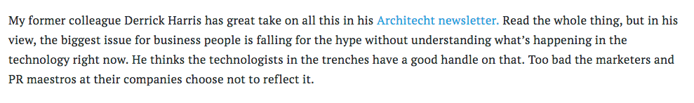

Slide 52
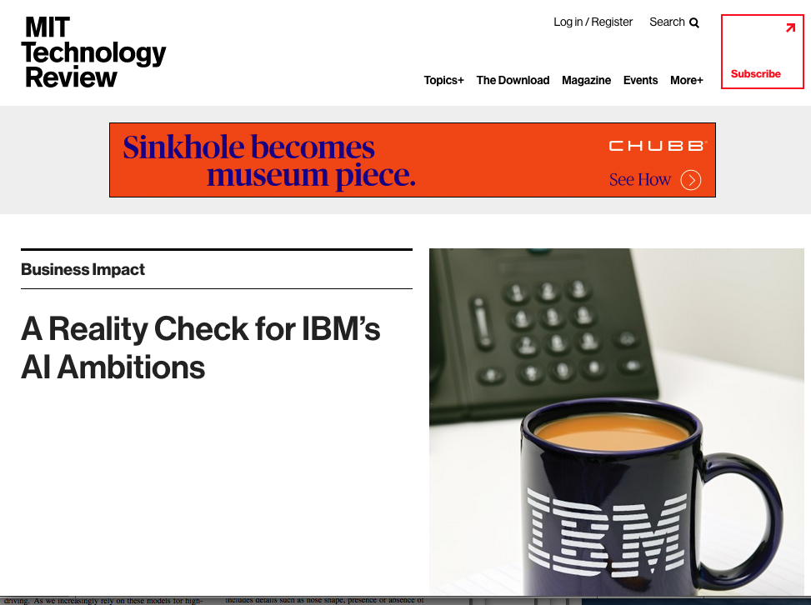
Read the article… but essentially...
“Whoops! Where’s the labeled training data?!”

Slide 53
#7
Predictive analytics projects generally start with high uncertainty and therefore high risk. Start simple and keep iterating.

Slide 54

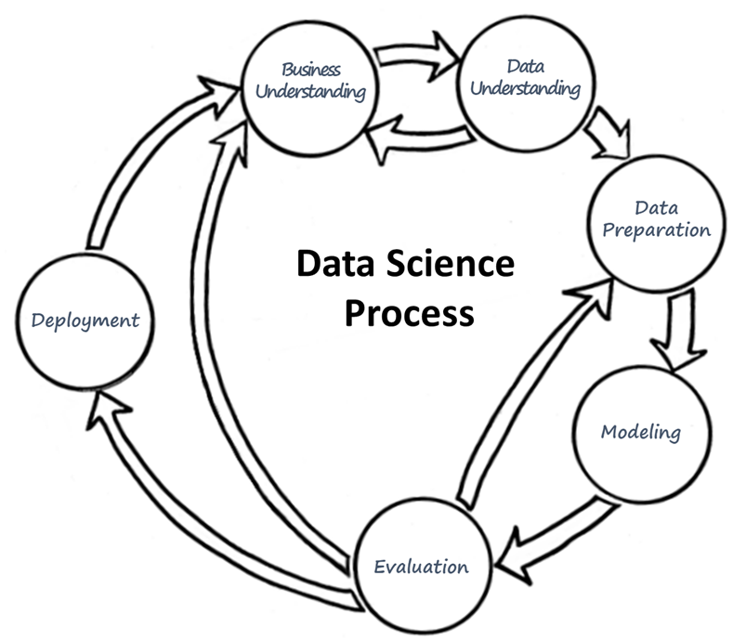
Investing in Predictive Analytics
“the biggest issue for business people is falling for the hype without understanding what’s happening.”
Notes:
It would be great if you could highlight on this slide the concept of having an AI "roadmap" where you start small with discrete use-cases, iterate and learn, then move onto more use-cases.

Slide 55

So remember…
Don’t fall in love with the machine!
I hope you enjoyed the course as much as I did!
Notes:
Seriously: Ignoring how the process and technologies work can lead to bad investment decisions in machine learning-based technological solutions.

